Slide 1

Retail Sales Analysis Project
Comprehensive analysis of 19M sales transactions revealing strategic insights to optimize marketing, enhance customer engagement, and drive revenue growth across product categories and sales channels.

Slide 2

Project Scope
Understanding Retail Performance
Business Challenge
Dataset Scale
A leading retail company needed to understand evolving sales patterns to enhance performance, customer satisfaction, and long-term loyalty across demographics, product categories, and sales channels.
19M records of sales transactions
Time frame: 2017-2019
19 attributes analyzed
37 null records cleaned
Mina

Slide 3
Technical Methodology
01
02
Data Preparation
Database Architecture
Python-based EDA with feature engineering, creating temporal metrics and performance indicators from raw transaction data.
Star schema implementation in MS SQL Server with fact and dimension tables for optimized querying.
03
04
Advanced Analytics
Visualization
SQL queries with window functions and CTEs to extract actionable insights from complex patterns.
Power BI dashboards with interactive filtering, drill-through capabilities, and executive reporting.
Mina

Slide 4

Data Engineering Excellence
Feature Engineering
Star Schema Design
Revenue per Unit calculated
FactSales: Transaction metrics
Stock Turnover metrics
Temporal features extracted
DimProduct: Product hierarchy
DimStore: Store attributes
DimDate: Time intelligence
Quality Validation
Zero missing foreign keys
Logical value imputation
Type consistency verified
Mina

Slide 5
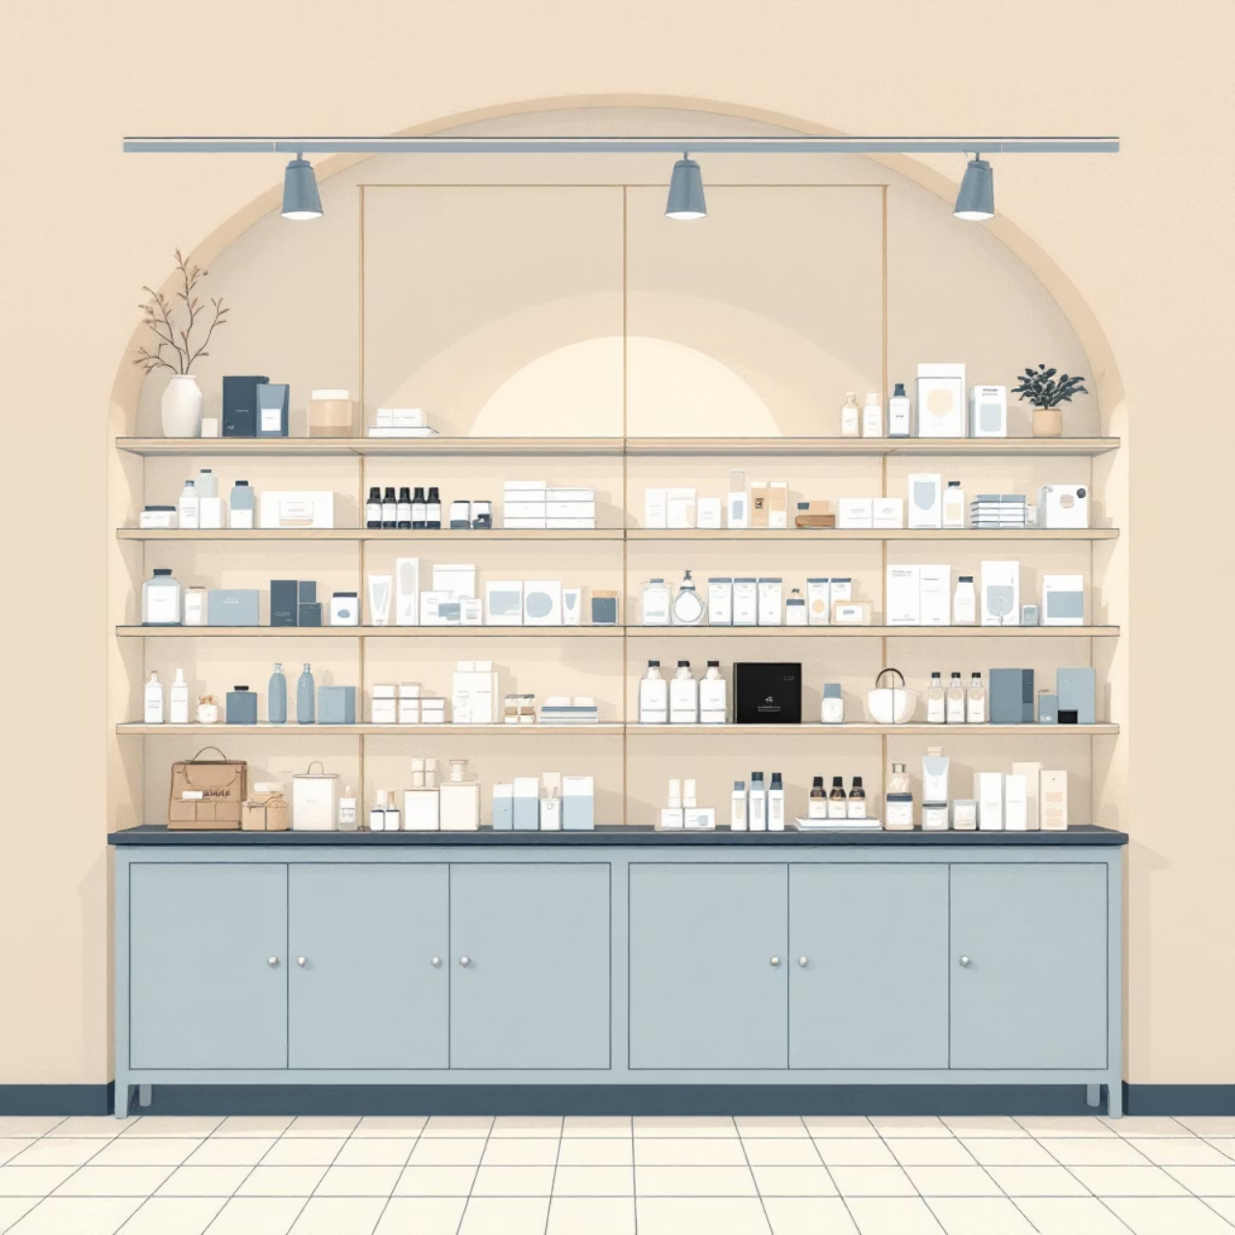
Product Performance Insights
84%
30%
Revenue Concentration
Profit Margin
Top hierarchies H00 and H01 generate 84% of total profit
Assumed margin used for profitability analysis
Analysis of hierarchy3 level products revealed significant revenue concentration, enabling targeted inventory and marketing strategies for high-performing categories.
Mina

Slide 6

Store Performance Analysis
Top Performers
Space Efficiency
Store types ST04 and ST01 generate 83% of revenue. These locations demonstrate optimal performance and should serve as models for improvement initiatives.
ST04 and ST01 achieve highest revenue per square meter, indicating superior space utilization and customer traffic management.
Performance Gap
Bottom 5 stores require training plans and operational support. Top performers need recognition programs to maintain excellence.
Mina

Slide 7
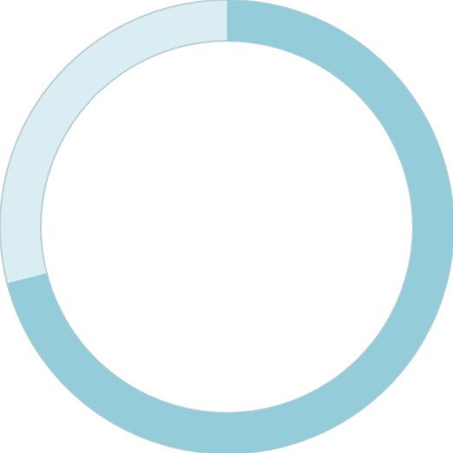

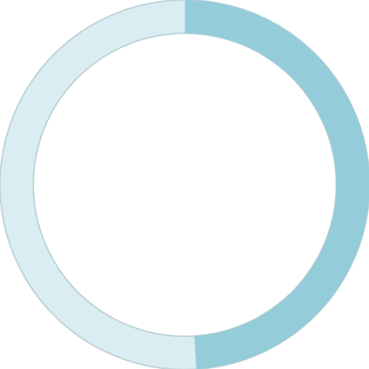
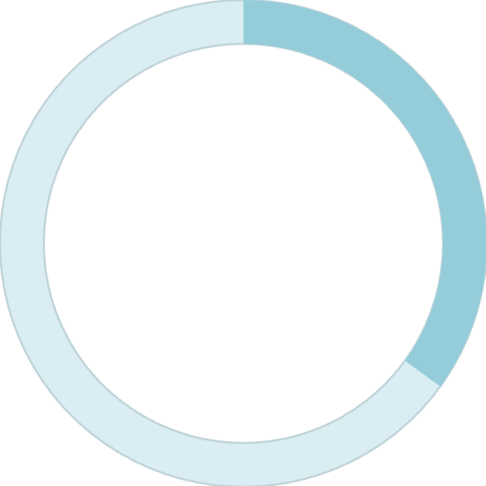
Promotion Campaign Success
Promo Type 1
Promo Type 2
71%
99.6%
Sales Impact
Dominance
PR03 and PR07 combined
PR03 market share
49%
35%
PR03 Share
City Focus
Of promo type 1 sales
C014 and C022 contribution
471K total sales achieved through promo type 1 campaigns
19M total sales driven by promo type 2, with PR03 proving exceptionally effective in cities C014 and C022
Mina

Slide 8




Inventory & Seasonal Trends
Peak Season
May to August represents highest revenue period, requiring increased inventory and staffing
Stock Turnover
Clusters 3, 7, and 9 represent 45% of turnover; H02 shows 40% of top sales-to-stock ratio
Optimization
Align inventory levels with category performance to reduce holding costs and stockouts
Mina

Slide 9
Strategic Roadmap
Immediate Actions (0-3 Months)
1
Enhance loyalty program targeting returning customers
Optimize discount strategy for high-margin products
2
Medium-term (3-6 Months)
Deploy PR03 campaigns in cities C014 and C022
Implement personalized marketing campaigns
Align inventory with performance insights
3
Improve customer journey touchpoints
Long-term Strategy (6-12 Months)
Develop predictive churn models
Optimize customer lifetime value
Launch data-driven product development
Mina

Slide 10









Impact & Next Steps
Retention
Increase customer loyalty through targeted programs based on segment insights
Optimization
Optimize marketing spend with data-driven, segment-specific strategies
Innovation
Enhance product offerings using performance analytics and customer feedback
Efficiency
Improve operations through pattern recognition and predictive analytics
This scalable technical foundation enables ongoing business intelligence and continuous optimization of retail performance.

